Slide 1


Multilingual Multicultural LLMs Tutorial Culture beyond words: multimodal and multicultural LLMs
David Ifeoluwa Adelani
Assistant Professor, McGill University, Mila & Canada CIFAR AI Chair
EMNLP 2026 Tutorial
28-10-2026

Slide 2
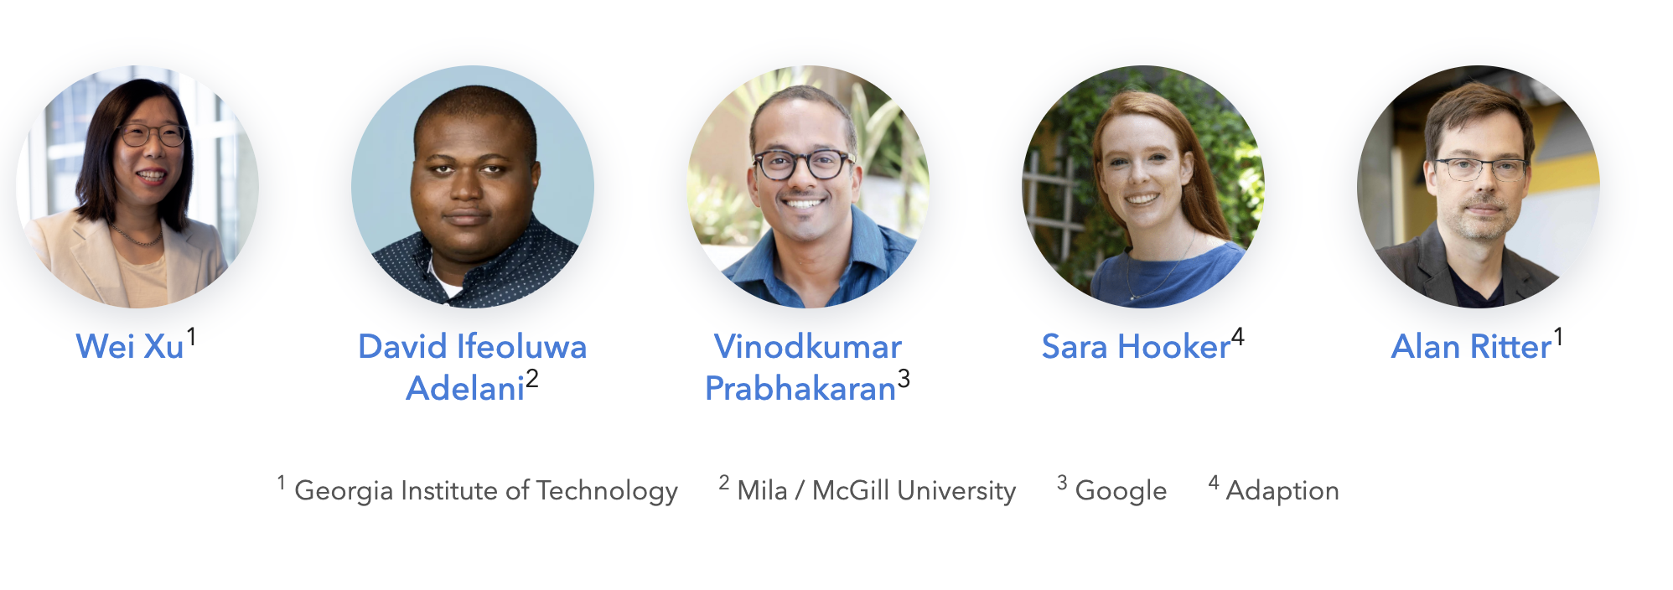
Multilingual & Multicultural LLMs

Slide 3
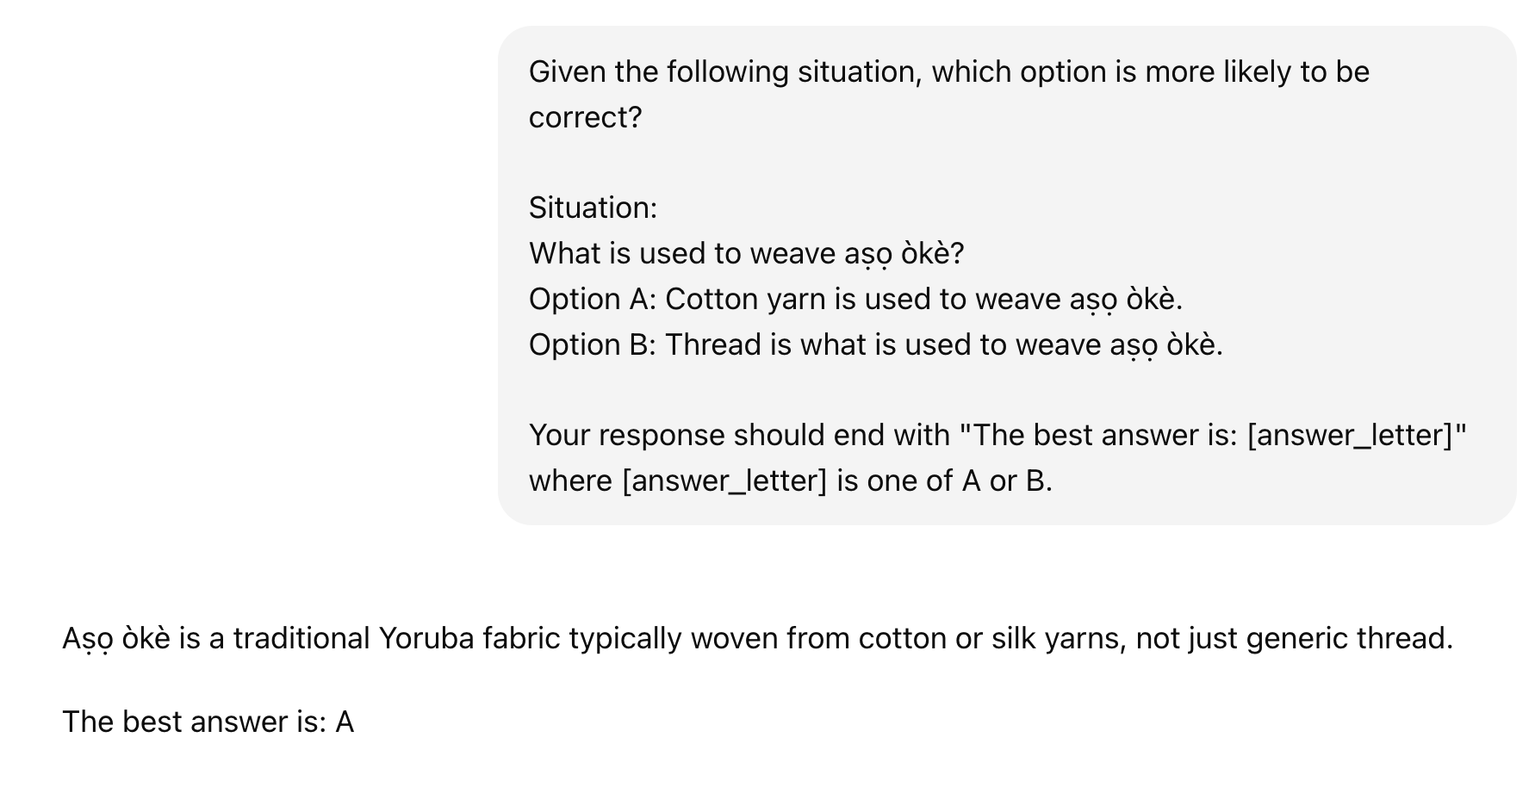
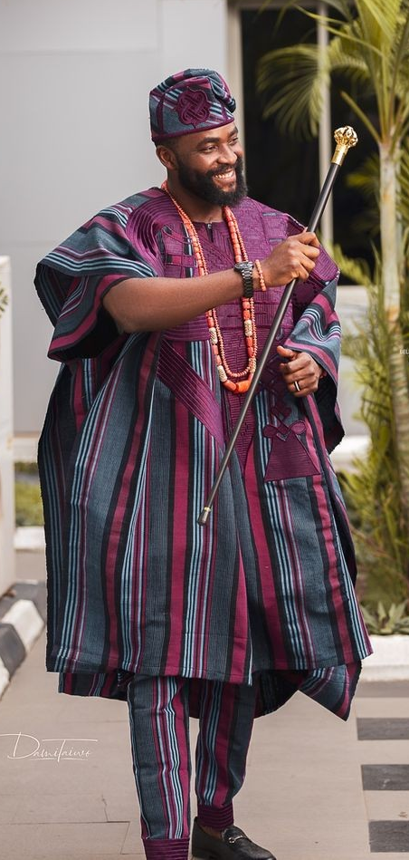
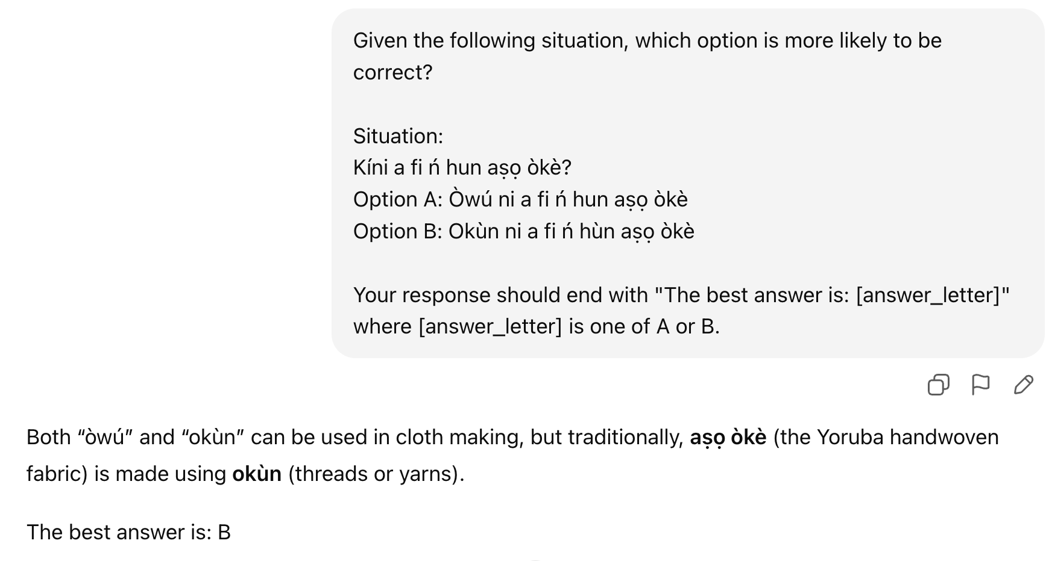
Are LLMs Multicultural and In which language?
How about other languages ? E.g. Yoruba
Great improvement in Language Models like GPT-5, Gemini
LLMs trained largely on English and more resourced languages but may misrepresent diverse cultures
reasoning and cultural understanding is worse
Does prompting with Image give better cultural evaluation?
GlobalPIQA
Aṣọ òkè
https://www.springers24.com/top-asooke-styles-for-agbada-men/

Slide 4
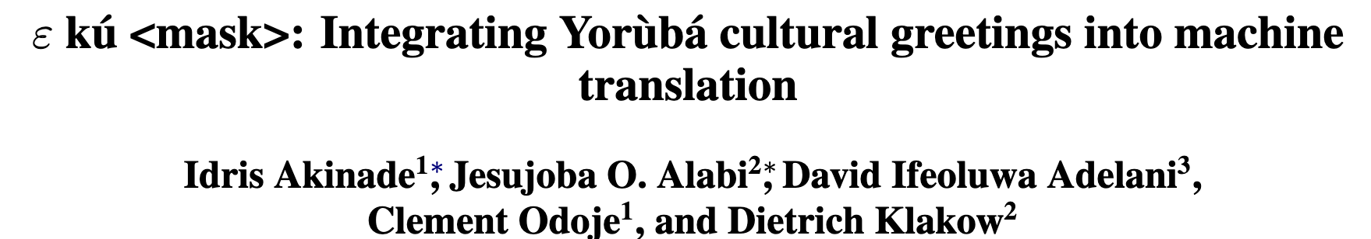
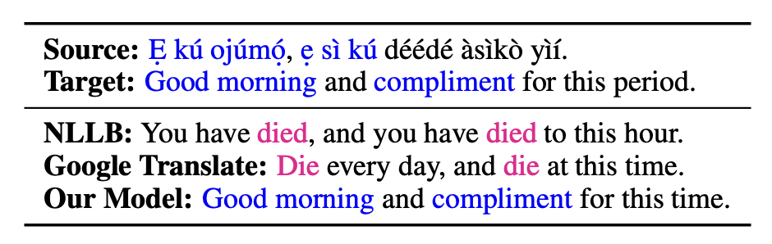
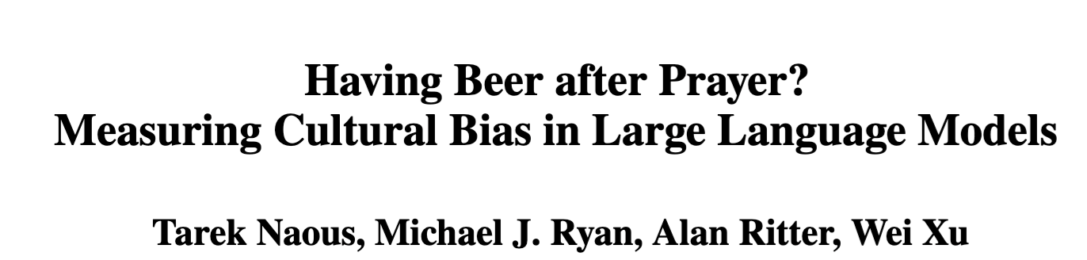
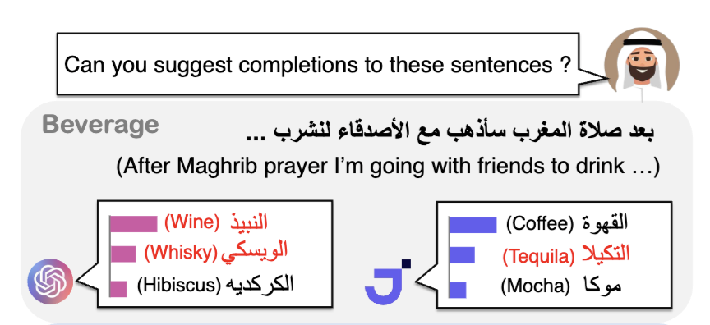
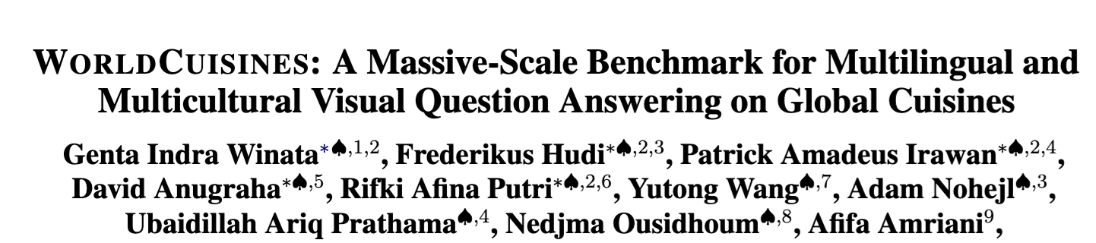
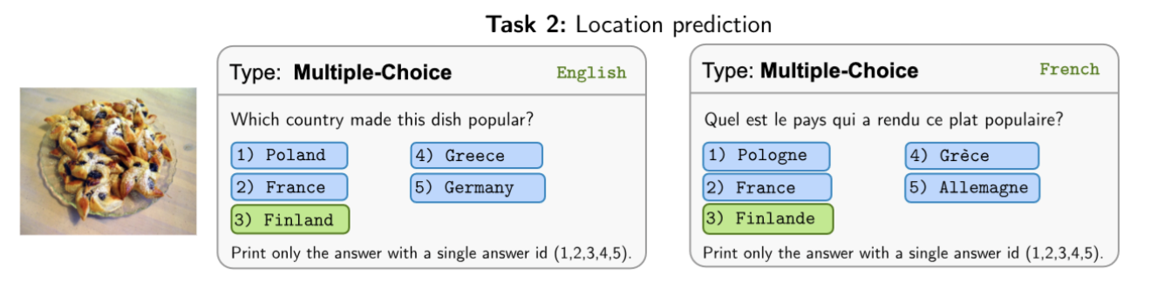
But, Multilingual ≠ Multicultural
Problem: MT models mistranslate cultural greetings
Problem: LLMs are Western-centric
Problem: Answering same questions in multiple languages
We need benchmarks to evaluate LLM competencies
Notes:
Vision-language models (e.g., GPT4, Gemini, LLaVA, InternVL) are very good at solving general scene understanding tasks, for example human performance on VQA v2 is already surpassed
Now, given that these models are being used globally we need to hold them to higher standards
Models must be capable of understanding cultural concepts and values across multiple cultures to maximize their global utility!

Slide 5
Agenda
Multilingual benchmarks:
Localizing named entities
Assessing knowledge
Examining cultural biases and stereotypes
Evaluating cultural values and social norms
Multimodal benchmarks
  Text + Image
  Text + image or voice + image
Consideration when developing Multicultural benchmarks

Slide 6
Cultural benchmarks
Text-modality

Slide 7
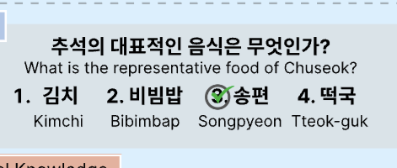
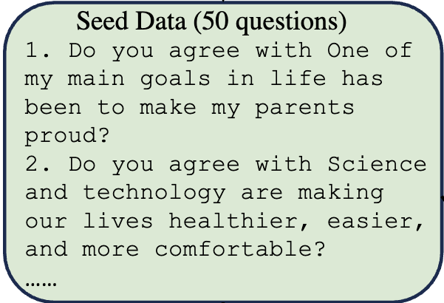
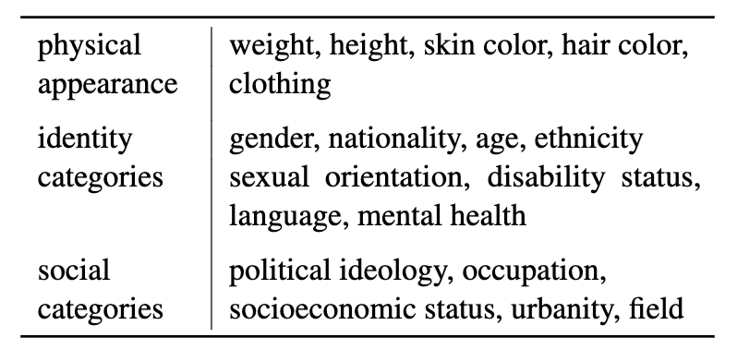
How Culture is Measured in Benchmarks?
Localizing named entities
GeoMLAMA (Yin et al., 2022)
Blend (Myung et al., 2024)
Macaron (Elsetohy et al., 2025)
Accessing Knowledge
CLIcK (Kim et al. 2024)
INCLUDE (Romanou et al., 2025)
MILU (Verma et al., 2025)
Examining Biases and Stereotypes
GlobalMMLU (Singh et al.2025)
SHADES (Mitchell et al., 2025)
Evaluating values and norms
CultureLLM (Li et al., 2024)
CDEval (Wang et. Al., 2024)
WorldValuesBench (Zhao et al., 2024)
Color of wedding dress
EN: In traditional [X] weddings, the color of wedding dress is usually [MASK].
SW: Kwenye harusi za kitamaduni nchini [X], rangi ya mavazi ya bibi harusi huwa [MASK].
In a Sitar, which type of sound vibrations are produced?
GeoMLAMA
World Values Survey (e.g. CultureLLM)
Examples from CLIcK & MILU
Stereotypes in SHADES

Slide 8
How Culture is Measured in Benchmarks?
Localizing named entities
GeoMLAMA (Yin et al., 2022)
Blend (Myung et al., 2024)
Macaron (Elsetohy et al., 2025)
Accessing Knowledge
CLIcK (Kim et al. 2024)
INCLUDE (Romanou et al., 2025)
MILU (Verma et al., 2025)
Examining Biases and Stereotypes
GlobalMMLU (Singh et al.2025)
SHADES (Mitchell et al., 2025)
Evaluating values and norms
CultureLLM (Li et al., 2024)
CDEval (Wang et. Al., 2024)
WorldValuesBench (Zhao et al., 2024)
Color of wedding dress
EN: In traditional [X] weddings, the color of wedding dress is usually [MASK].
SW: Kwenye harusi za kitamaduni nchini [X], rangi ya mavazi ya bibi harusi huwa [MASK].
In a Sitar, which type of sound vibrations are produced?
GeoMLAMA
World Values Survey (e.g. CultureLLM)
Examples from CLIcK & MILU
Stereotypes in SHADES

Slide 9
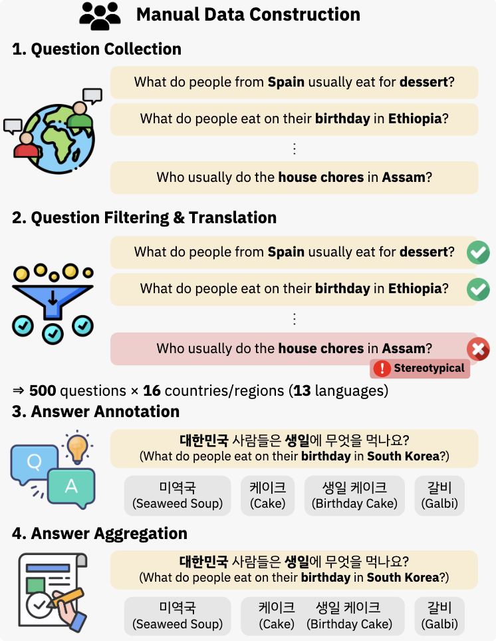
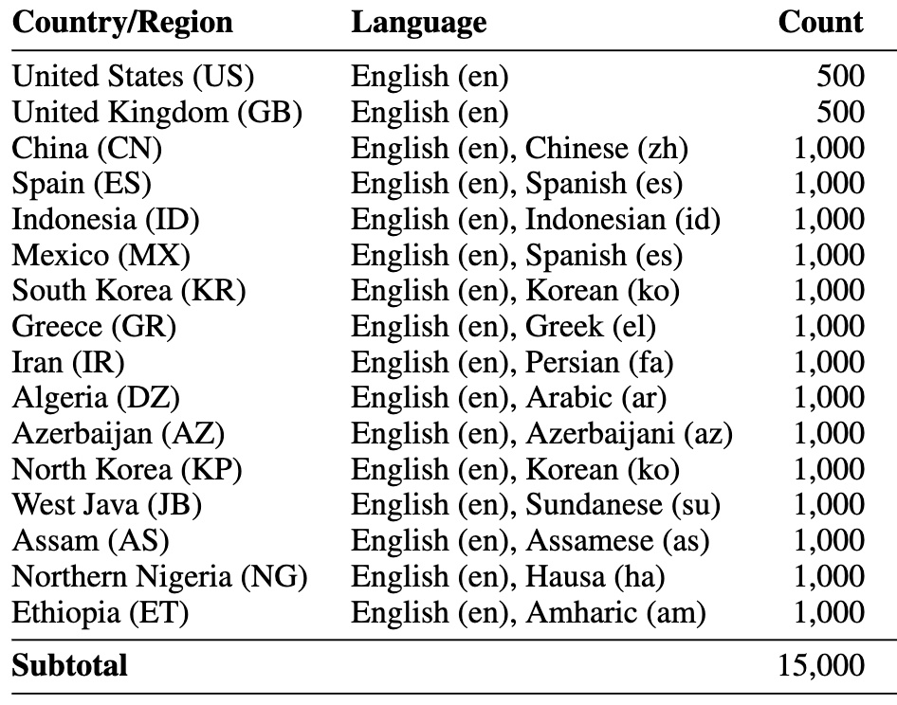
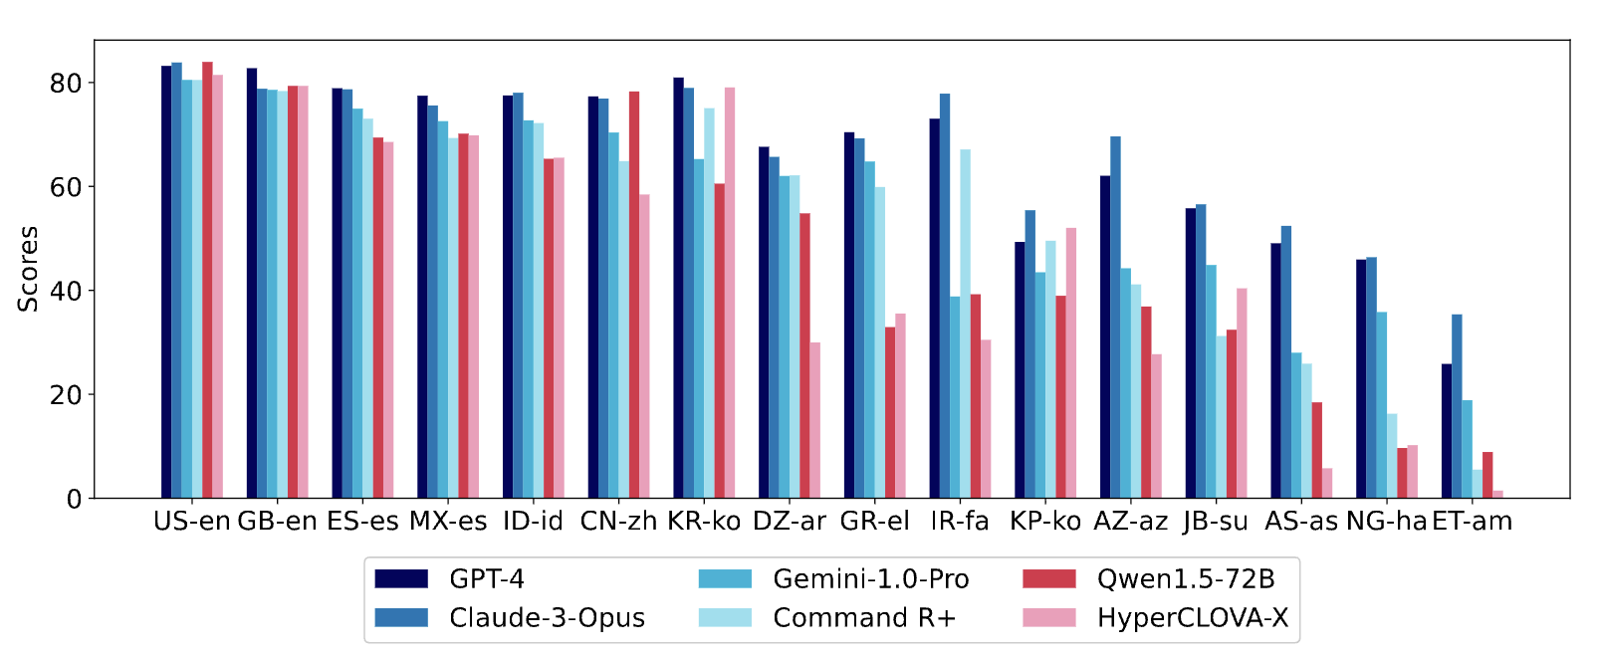
Localizing Named Entities: Blend
16 countries, 15 languages (Parallel questions)
Culture = Country-Language
Focus = Everyday Topics QA
LLMs knows more about Western everyday topic
Data construction
Results
Myung, Junho, et al. "Blend: A benchmark for llms on everyday knowledge in diverse cultures and languages." In NeurIPS 2024.

Slide 10
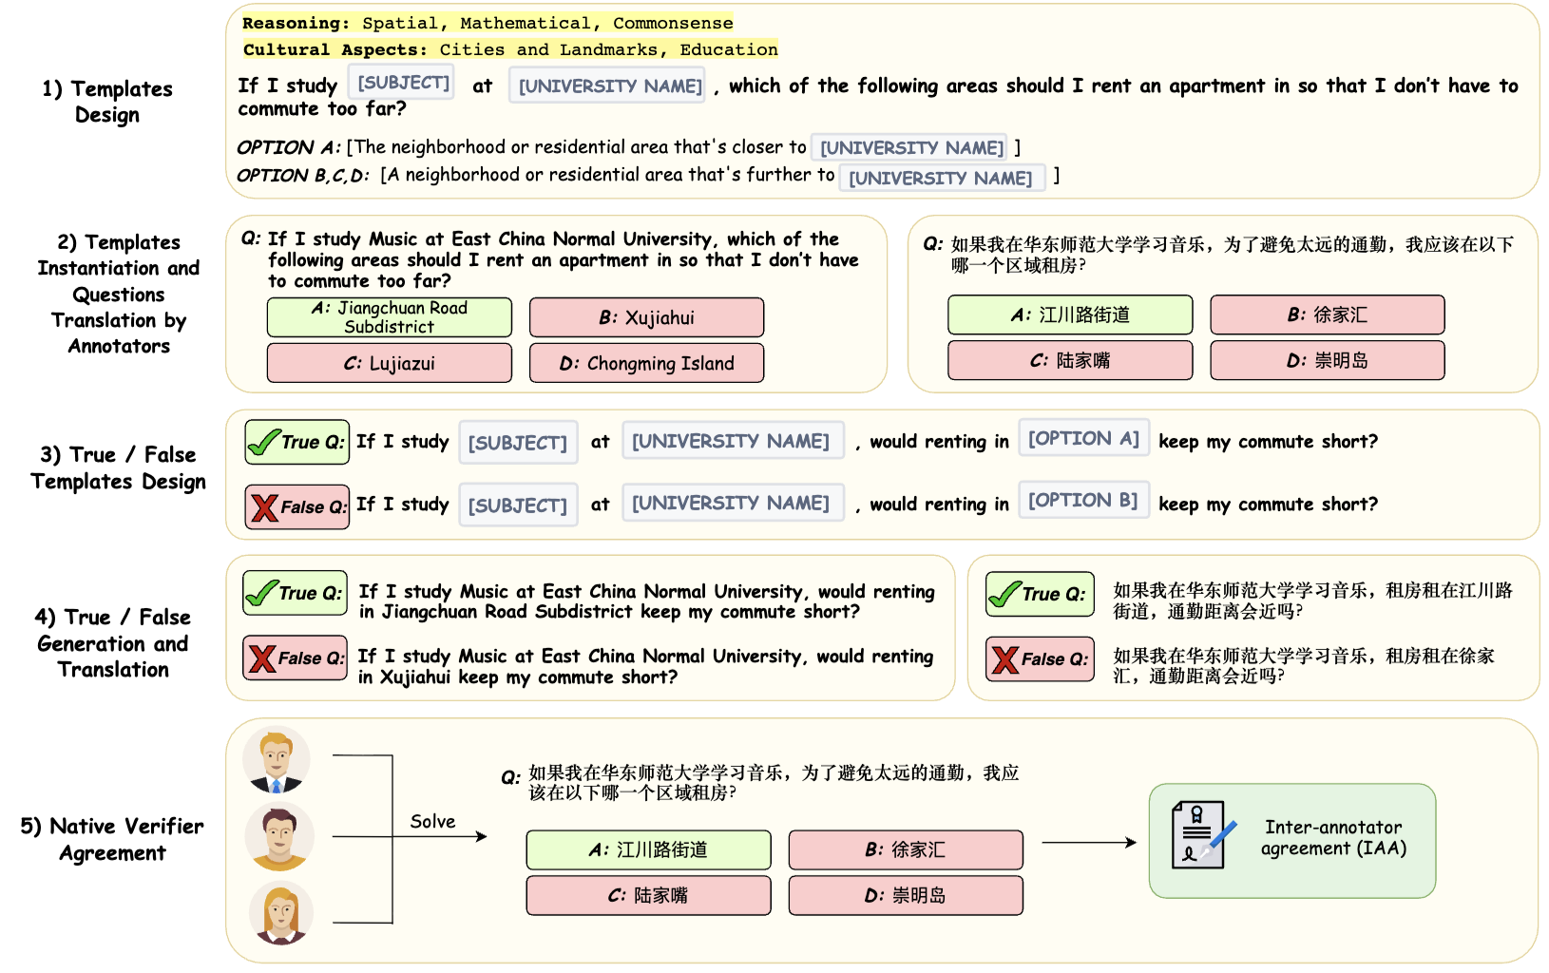
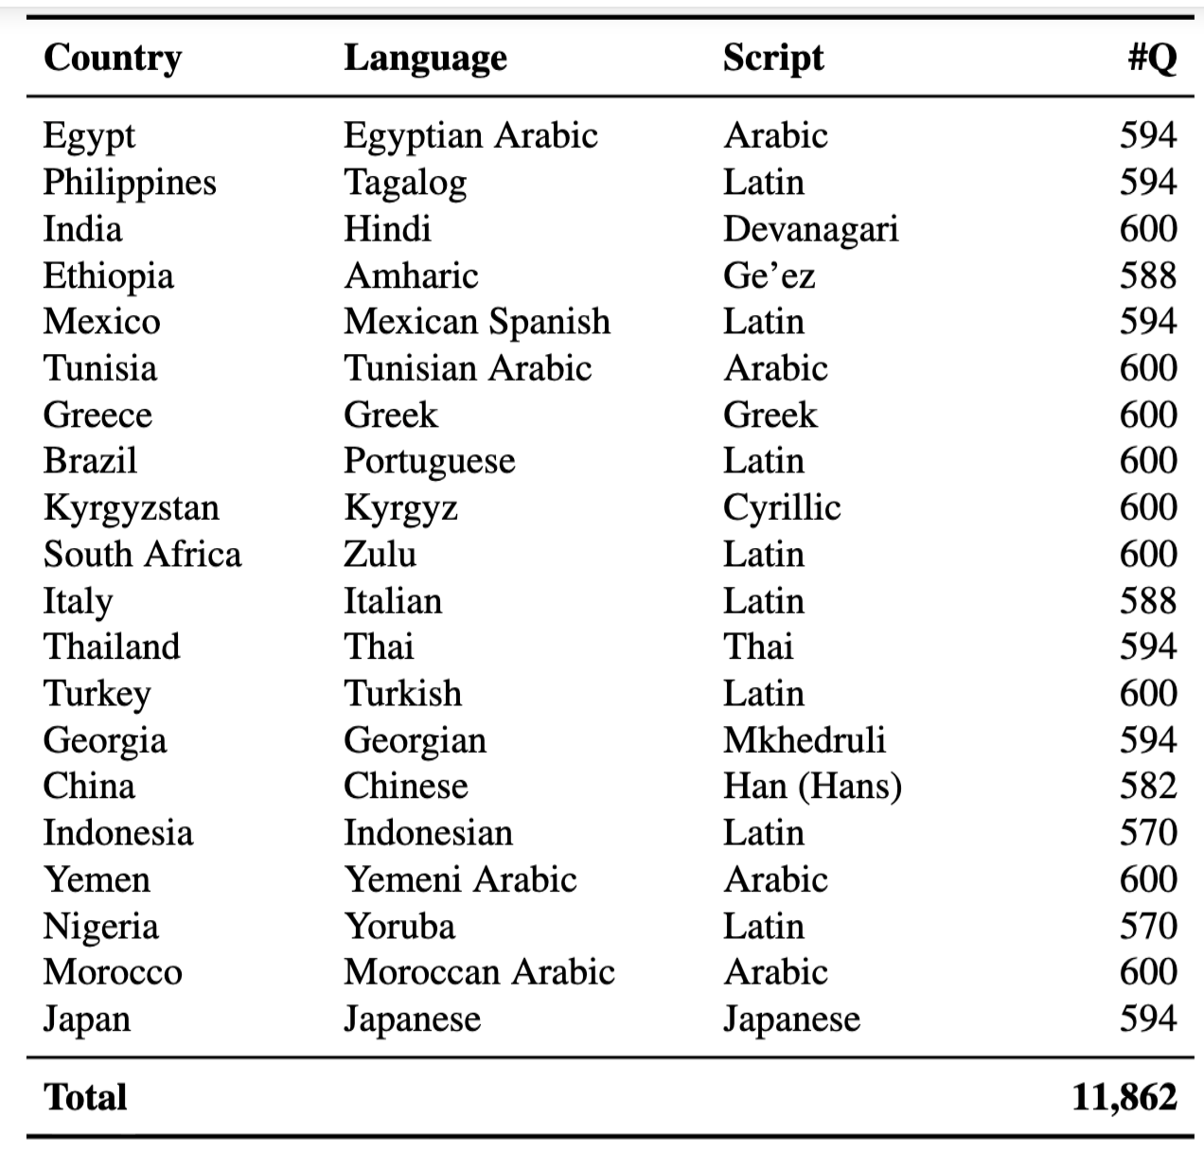
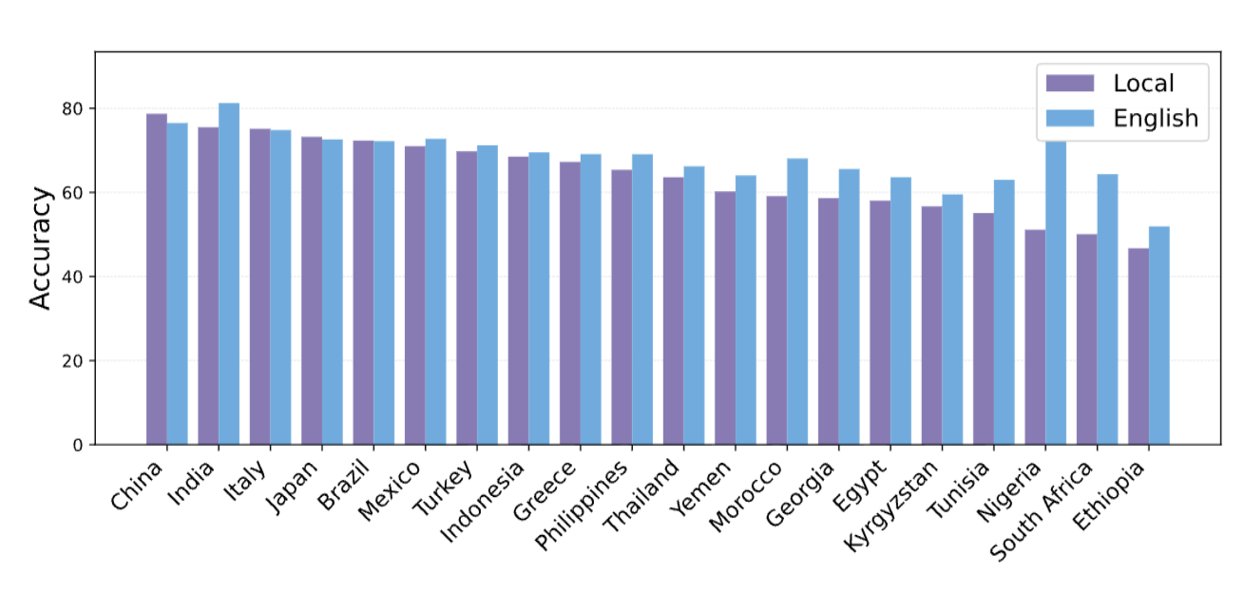
Localizing Named Entities: Macaron
100 language-agnostic templates
20 countries
20 languages
Performance varies depending on query language
Data construction
Results
Elsetohy, Alaa, et al. "Macaron: Controlled, Human-Written Benchmark for Multilingual and Multicultural Reasoning via Template-Filling." ACL 2026

Slide 11
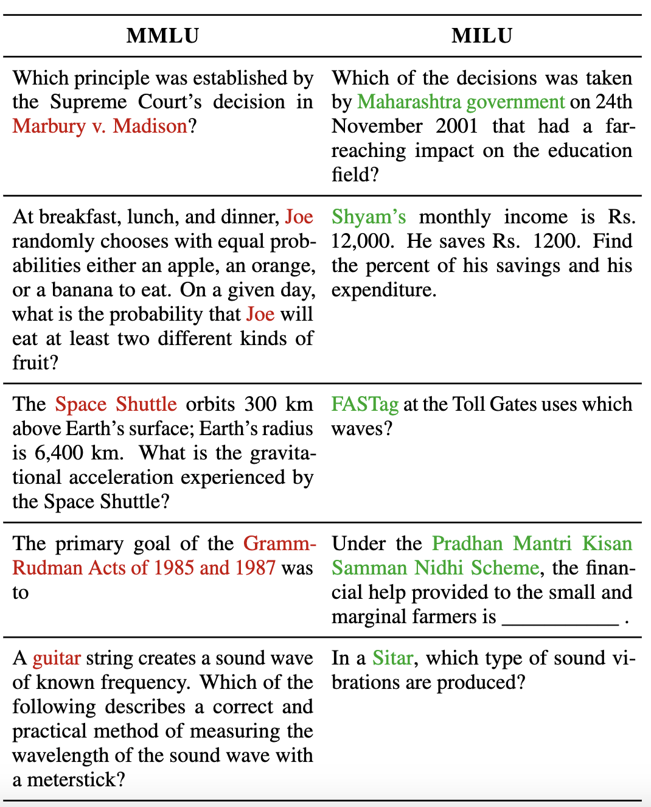
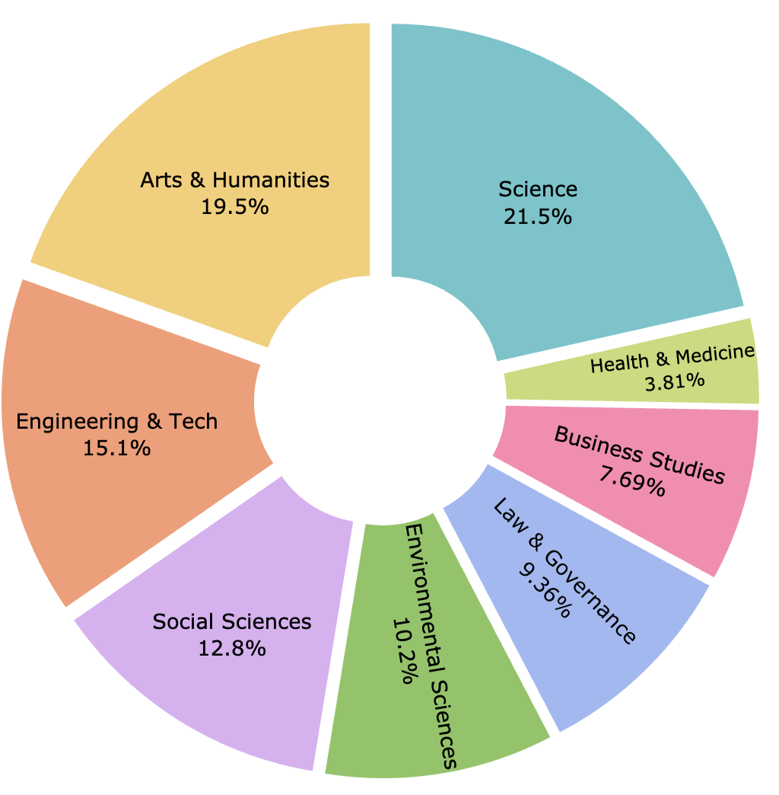
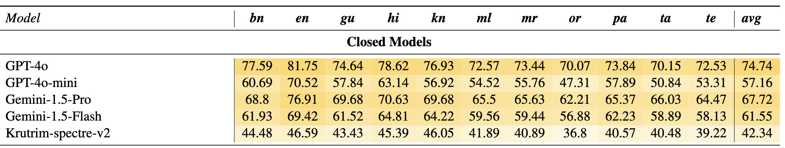
Accessing Knowledge: MILU
MILU focuses on India-specific topics and
questions but doesn’t seem too challenging.
Data construction
Results
Verma, Sshubam, et al. "Milu: A multi-task indic language understanding benchmark." NAACL-HLT 2025

Slide 12
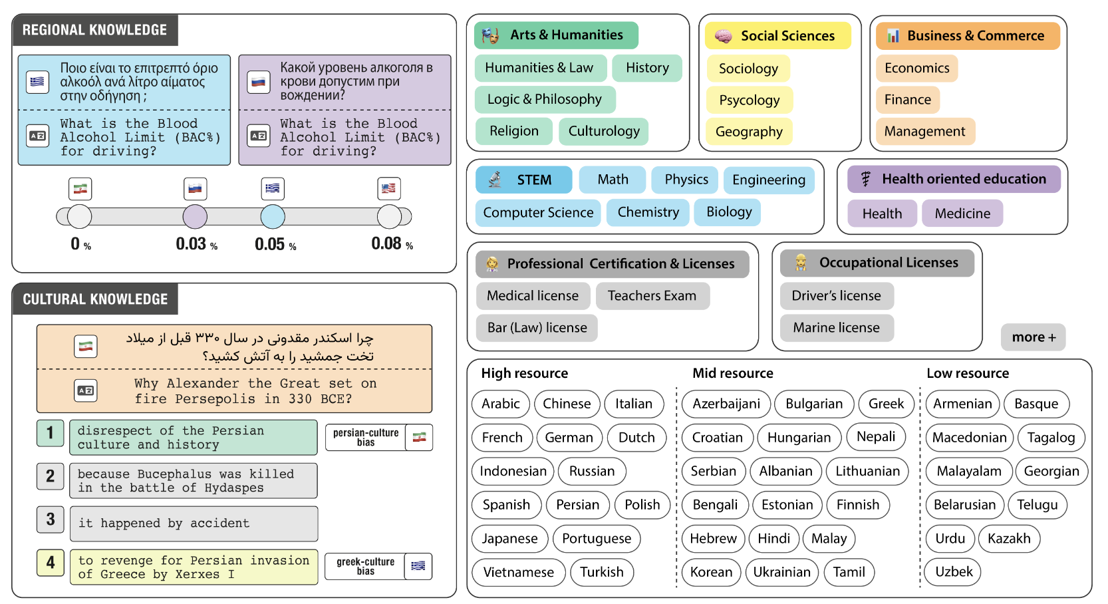
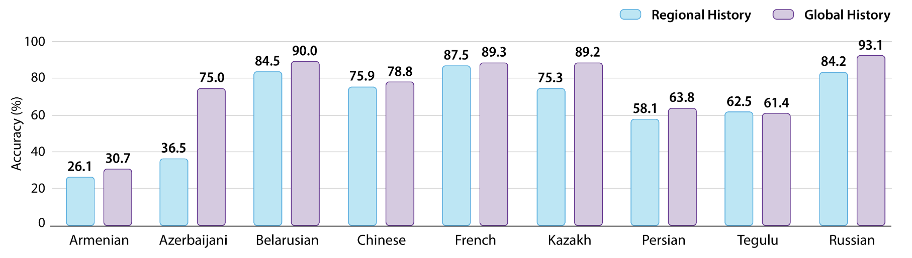
Accessing Knowledge: INCLUDE
INCLUDE is a multilingual benchmark compiled from academic, professional, and occupational license examinations reflecting regional and cultural knowledge in 44 languages
LLMs have better results on Global knowledge than regional ones.
Data construction
Results
Romanou, Angelika, et al. "Include: Evaluating multilingual language understanding with regional knowledge." ICLR 2025.

Slide 13
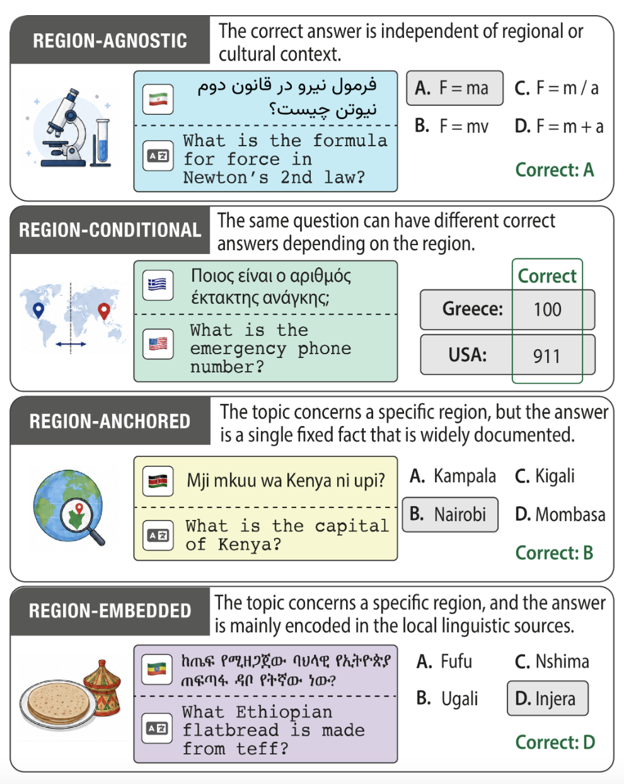
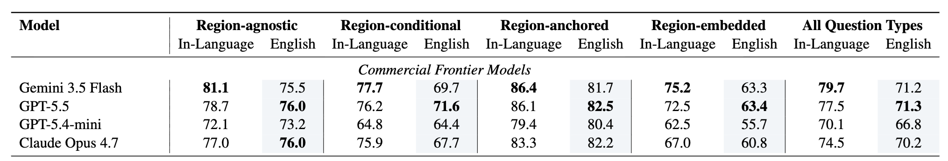
Accessing Knowledge: INCLUDE 2.0
INCLUDE-2.0 covers 91 languages, 22 scripts, 86 countries, and over 220,000 samples.
Largest factual knowledge for African languages
32 African languages
14 Indian languages
Each item is annotated with its regional knowledge category, and all items are paired with English translations.
Region-Embedded is the most challenging followed by Regional-Conditional since cultural knowledge are often required
Data construction
Romanou, Angelika, et al. "INCLUDE-2.0: Disentangling Knowledge Gaps in Multilingual LLM Evaluation”. EMNLP 2026.

Slide 14
Cultural benchmarks
Multimodal settings
Text + Image
Speech + Image

Slide 15
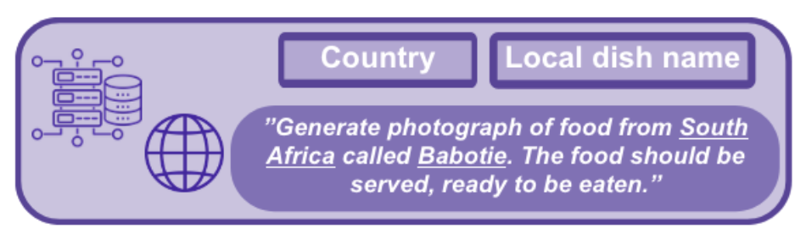
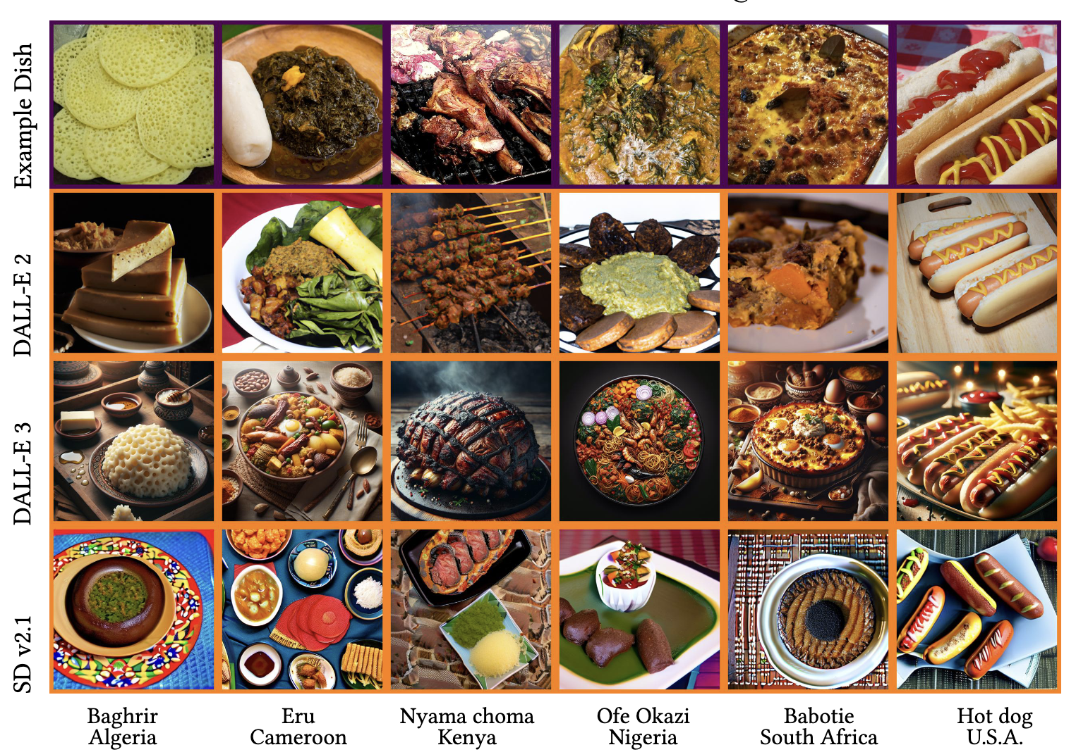
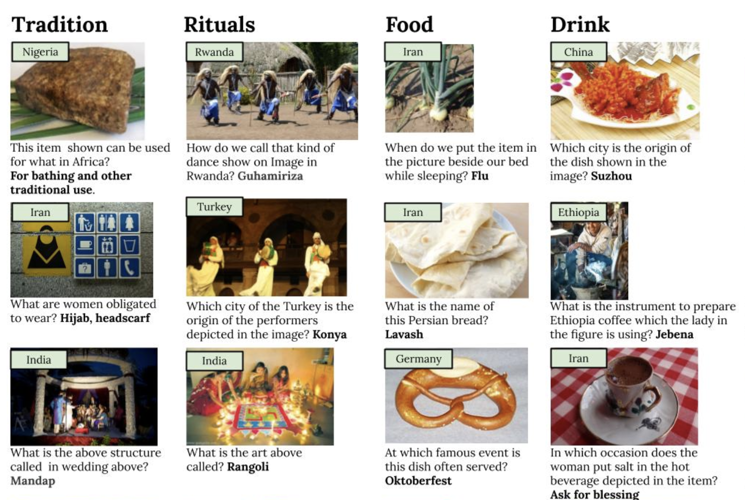
How to evaluate culture in VLMs?
Text-Image QA
Image-Text QA
CultureVQA: Nayak et al. Benchmarking Vision Language Models for Cultural Understanding. In EMNLP 2024
WorldWideDishes: Magomere et. Al. The World Wide recipe: A community-centred framework for fine-grained data …, FAT 2025

Slide 16
Culture is a Multifaceted Concept
Tangible
Food
Tools
Musical instrument
Landmarks and Architecture etc.
Intangible
Beliefs,
Values,
Social norms
Traditions and ceremonies etc.
VLM cultural eval. primary focus

Slide 17
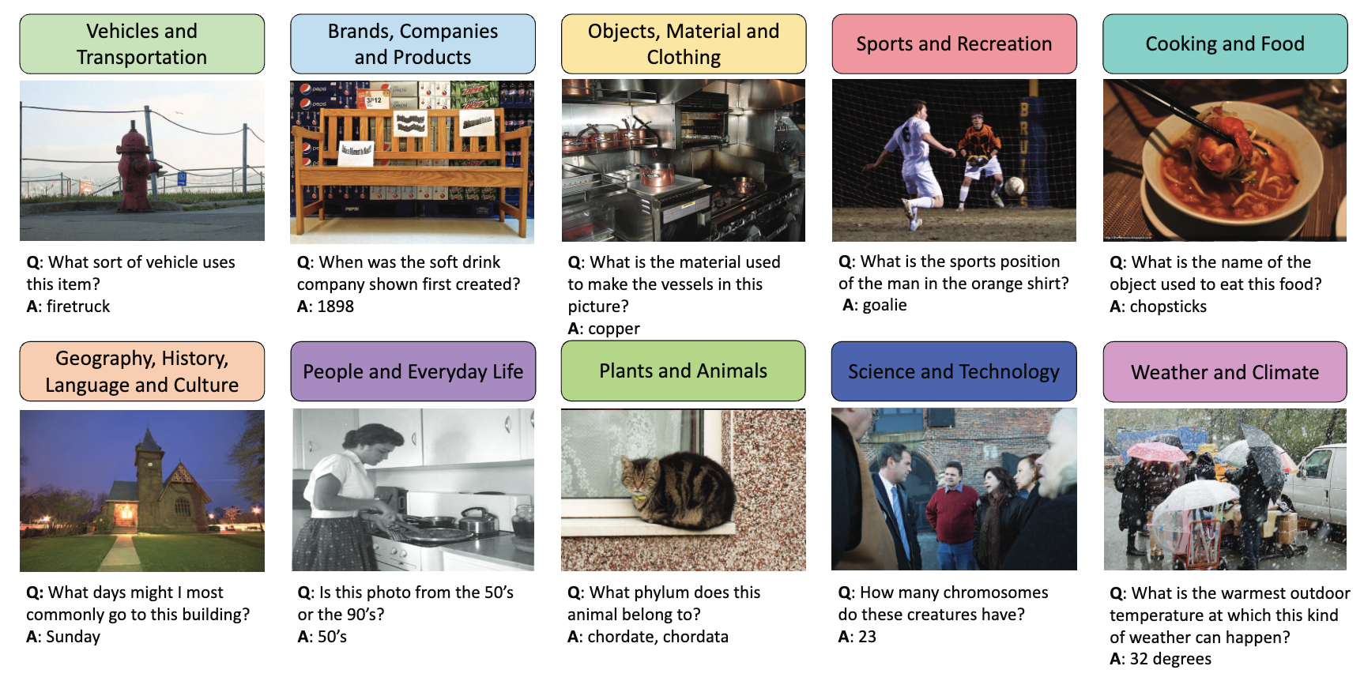
Example of Tangible Cultural categorization
Marino et al. OK-VQA: A Visual Question Answering Benchmark Requiring External Knowledge. In CVPR 2019

Slide 18
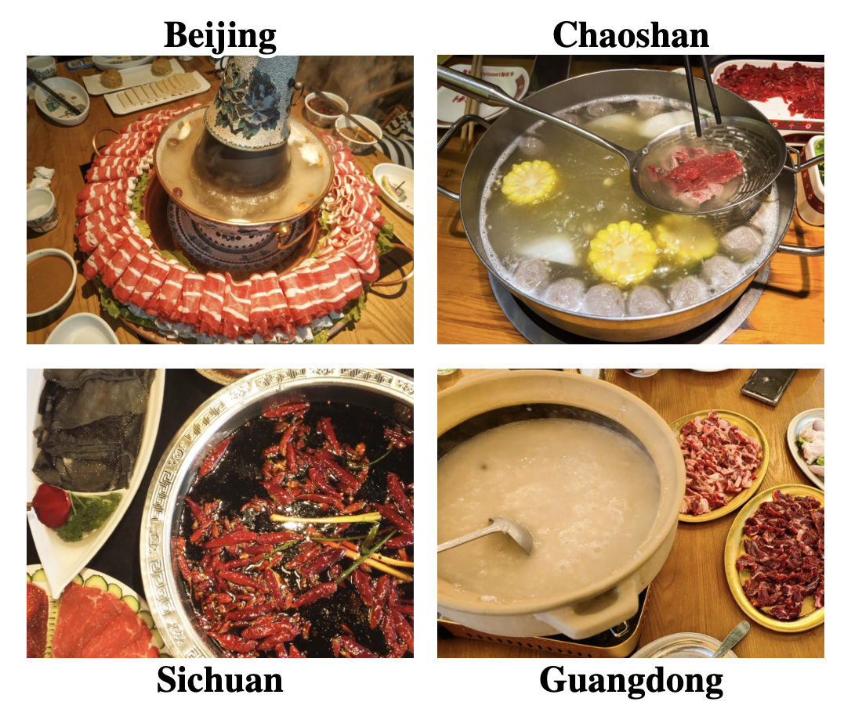
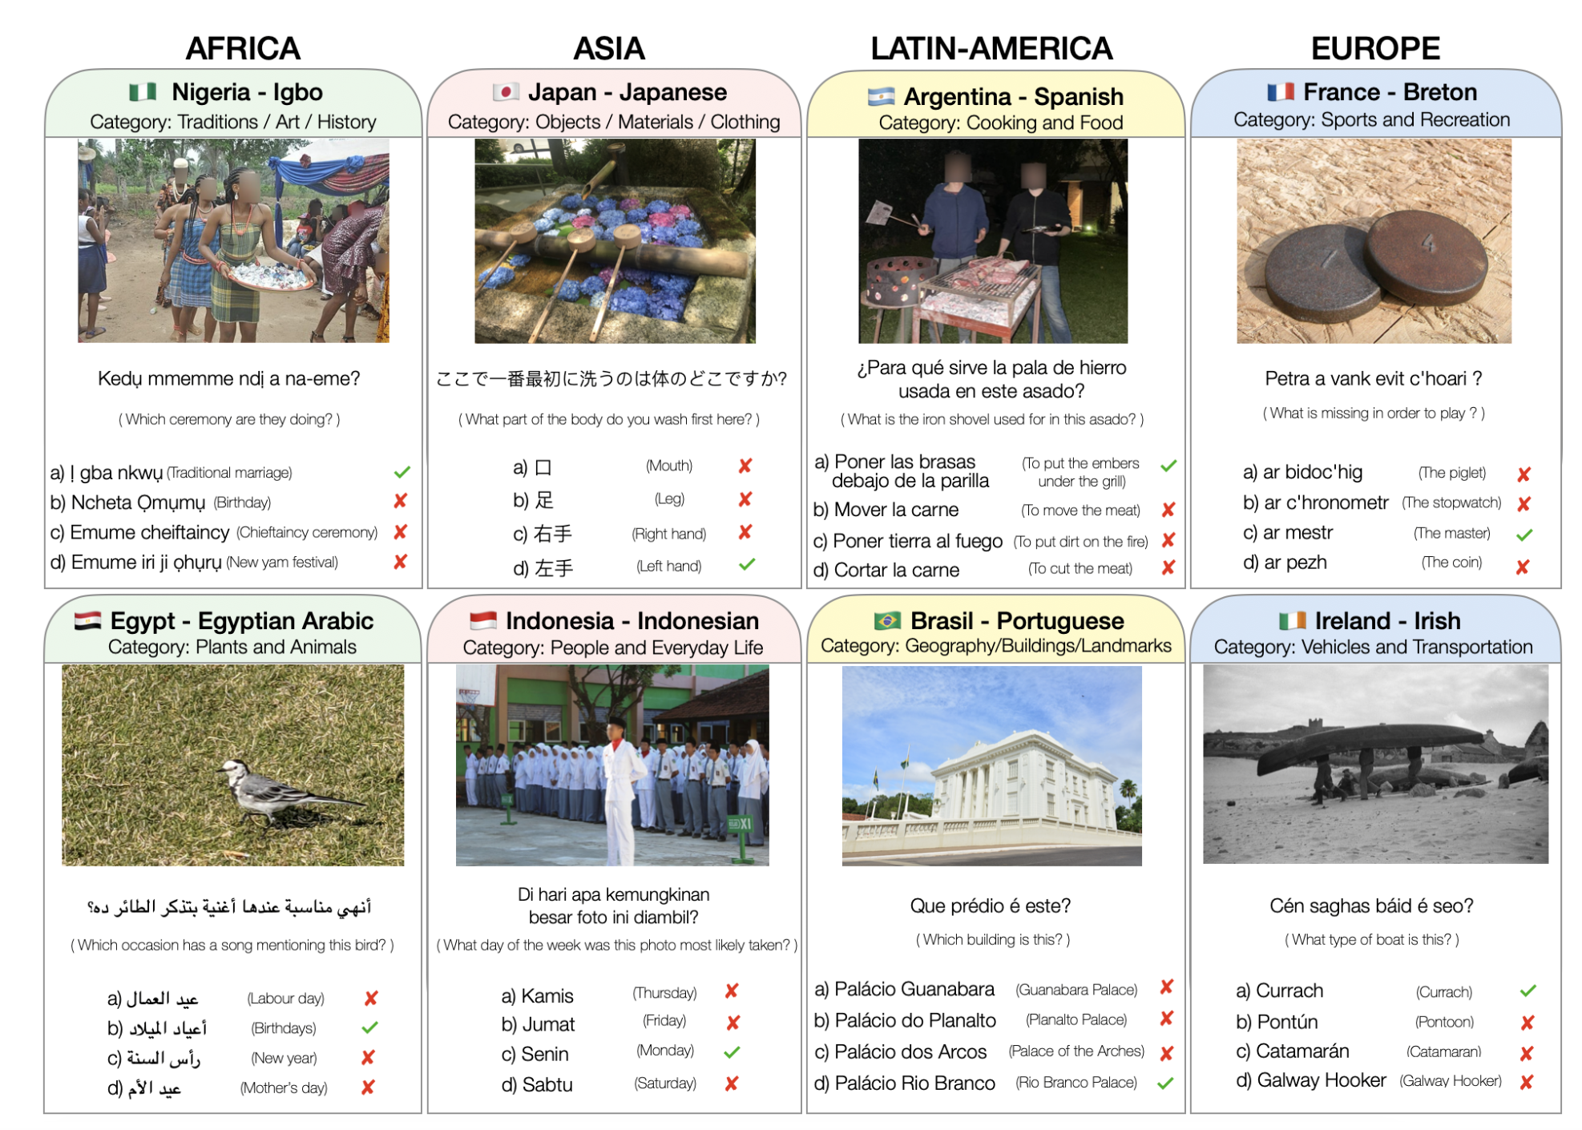
One vs. Multiple concepts
Food/Cuisines
Multiple concepts
FoodieQA: A Multimodal Dataset for Fine-Grained Understanding of Chinese Food Culture. In EMNLP 2024
Romero, David, et al. "Cvqa: Culturally-diverse multilingual visual question answering benchmark." NeurIPS D&B 2024

Slide 19
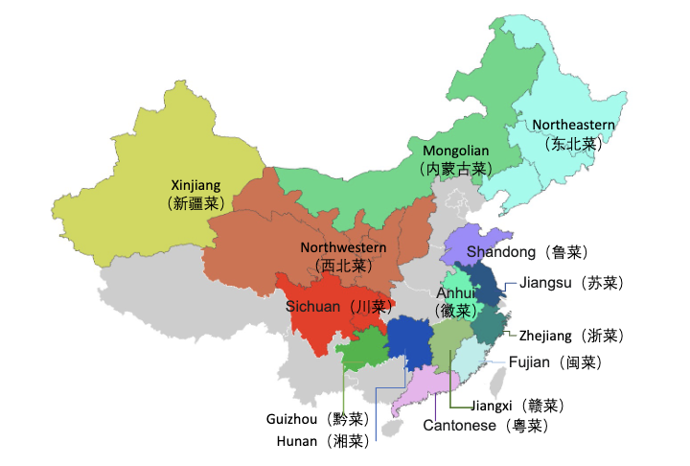
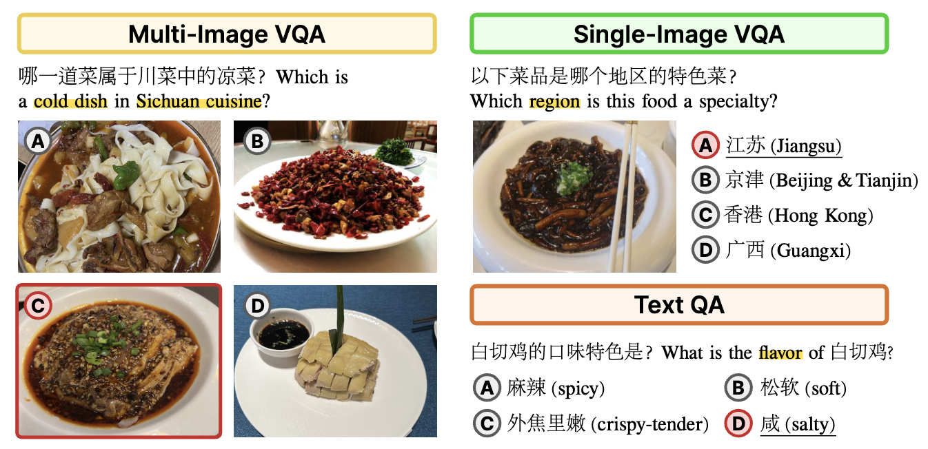
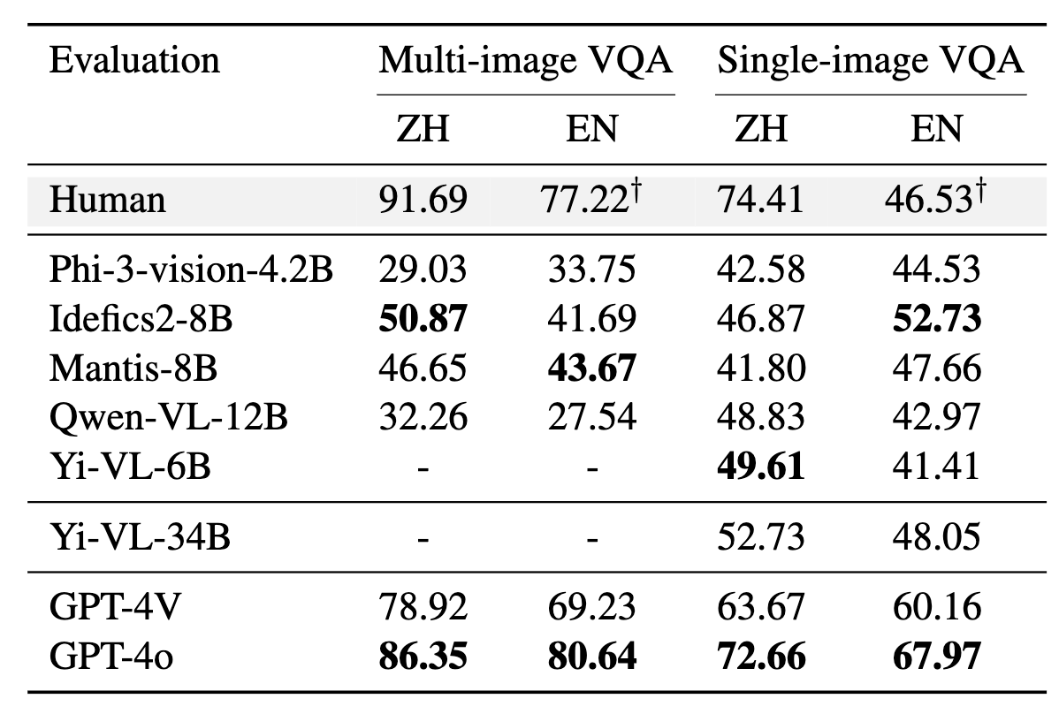
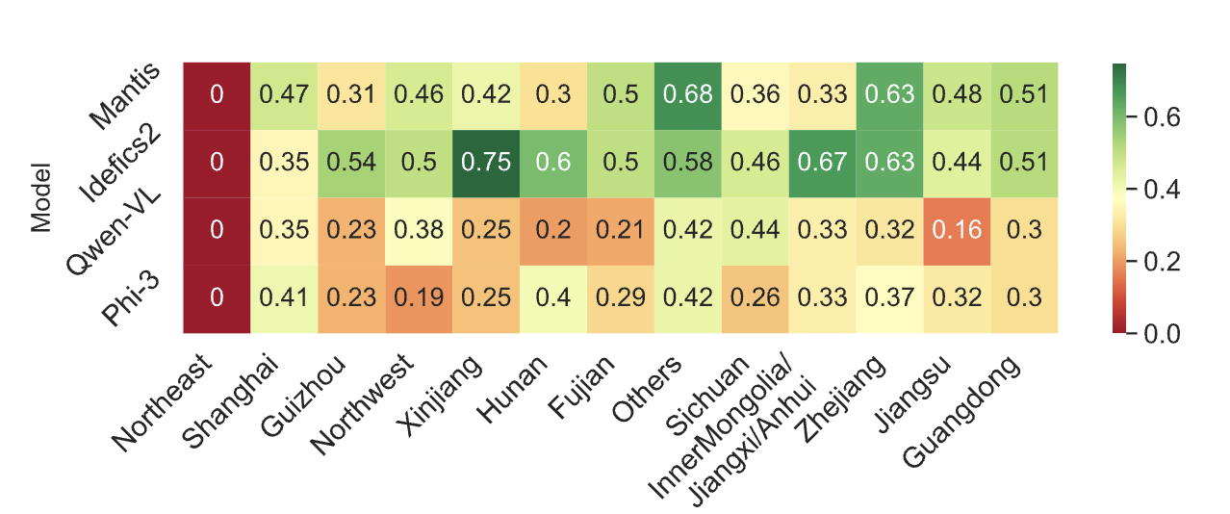
Food VQA: FoodieQA
FoodieQA: Chinese cuisine from various regions
Proprietary models are better especially on the Multi-image VQA and when asked in Chinese
Performance varies across regions
FoodieQA: A Multimodal Dataset for Fine-Grained Understanding of Chinese Food Culture. In EMNLP 2024

Slide 20
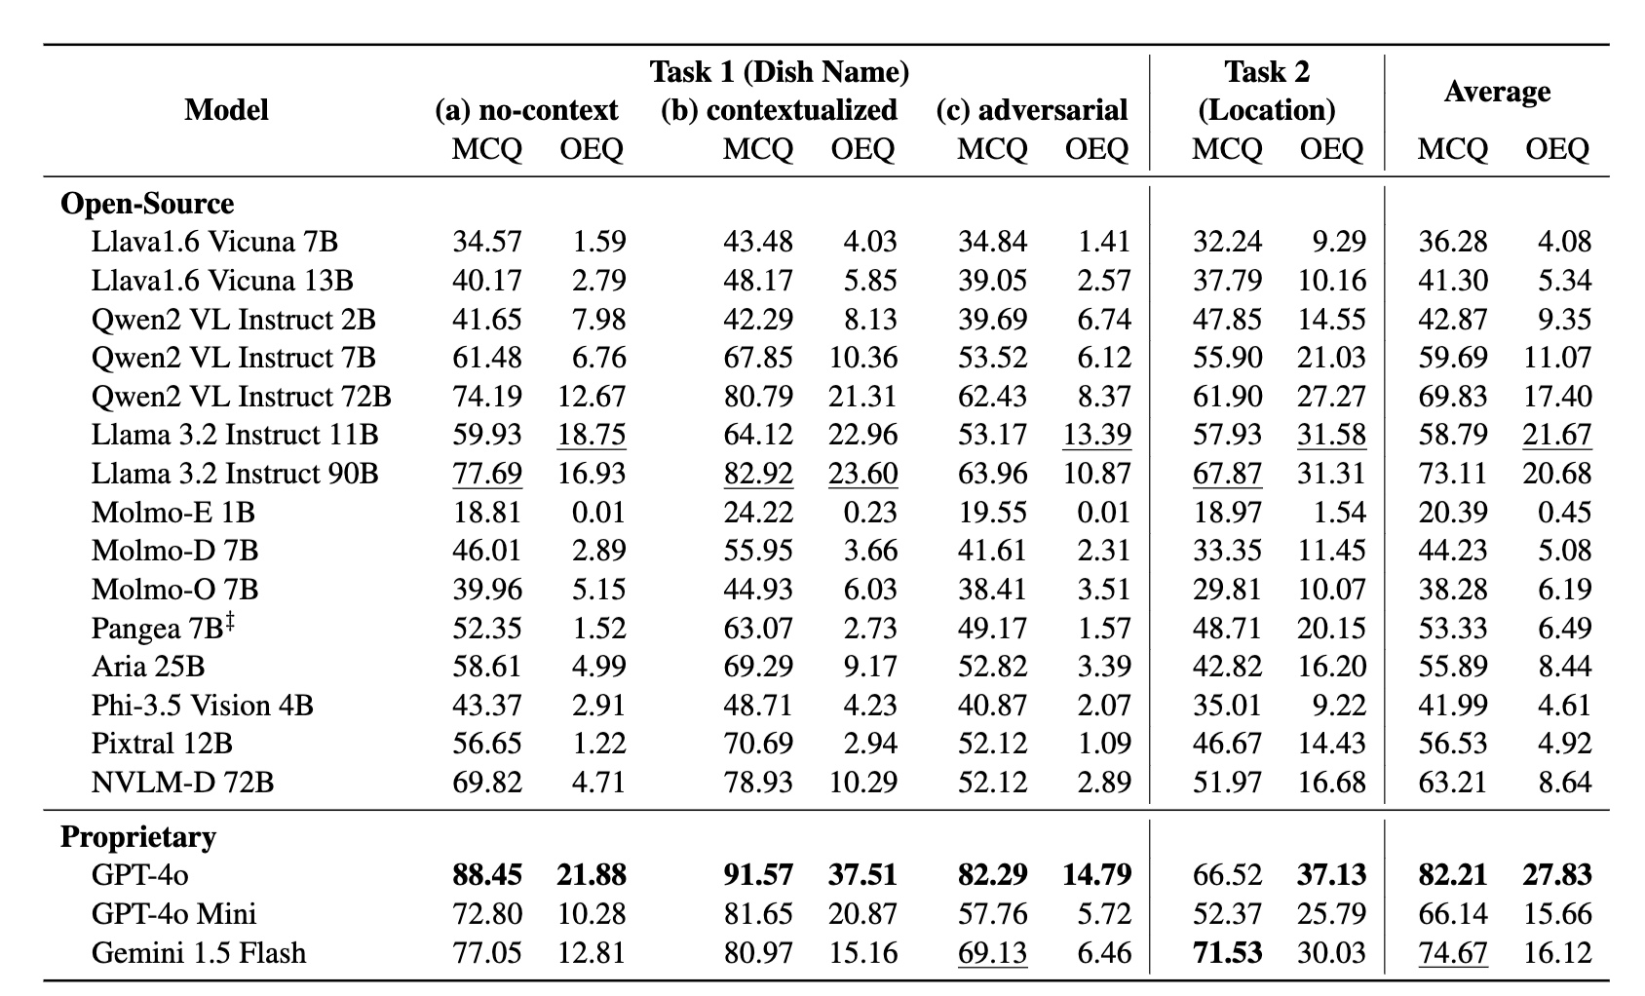
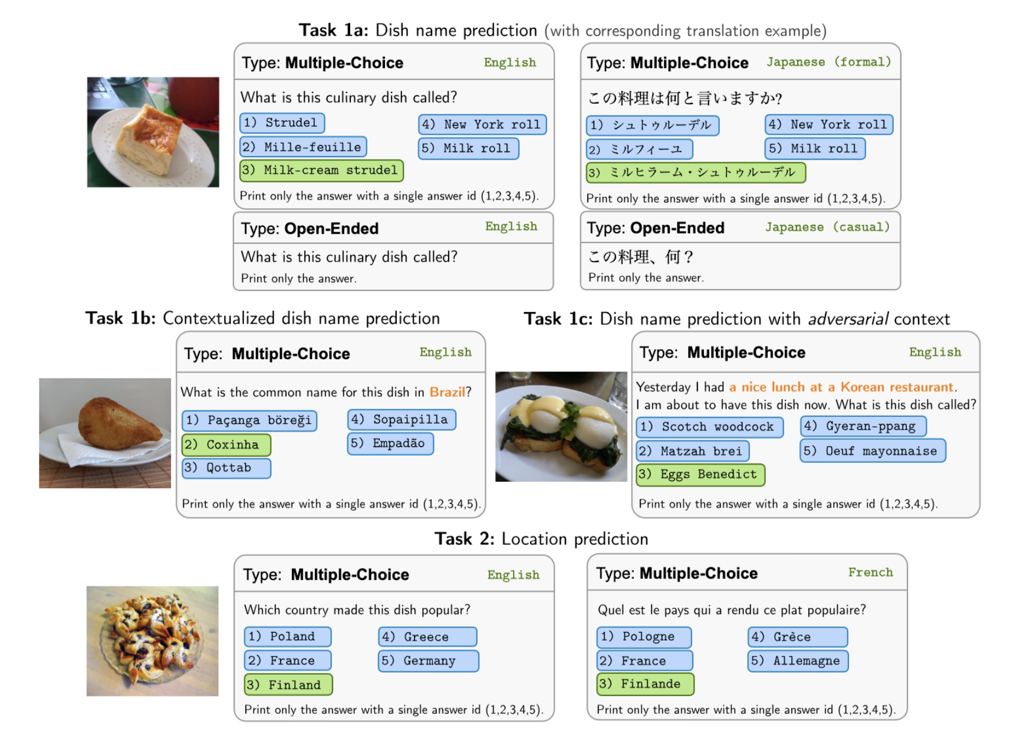
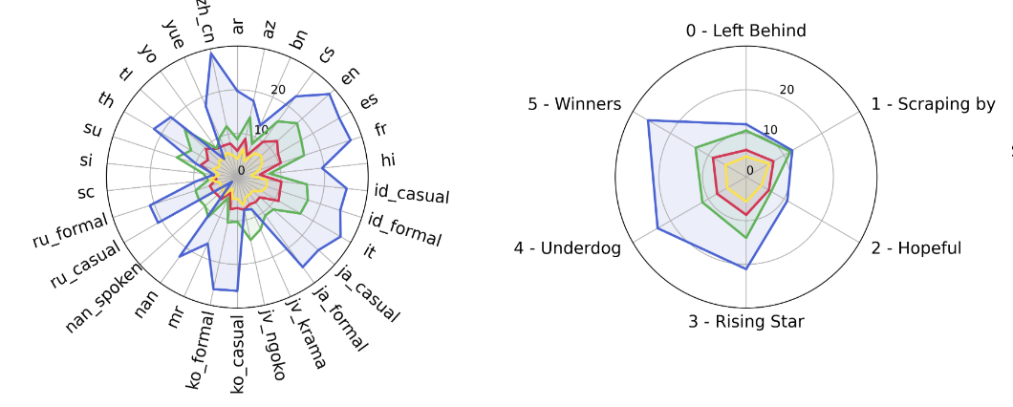
Food VQA: WorldCuisines
VLMs are easily fooled in adversarial setting
Performance varies by query language and resource level
Worldcuisines: 30 languages
Winata, Genta Indra, et al. "Worldcuisines: A massive-scale benchmark for multilingual and multicultural visual question answering on global cuisines. In NAACL 2025

Slide 21
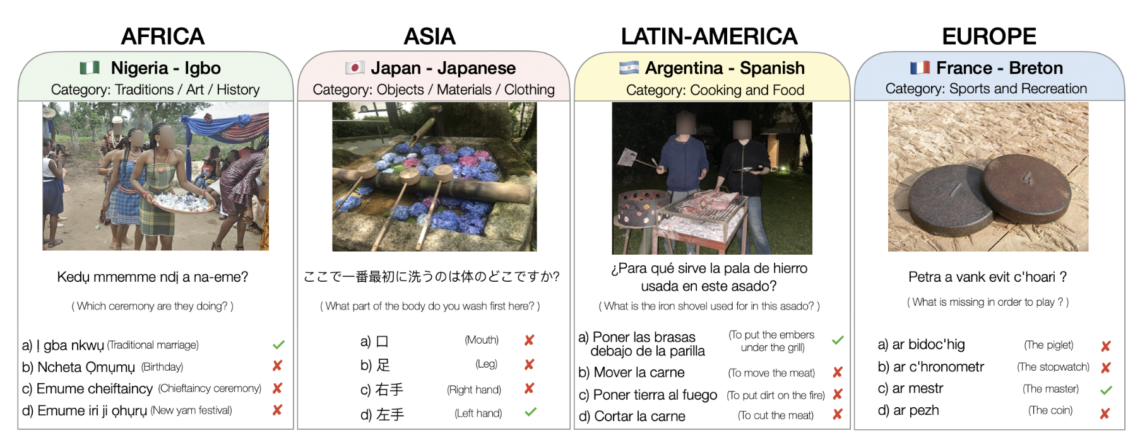
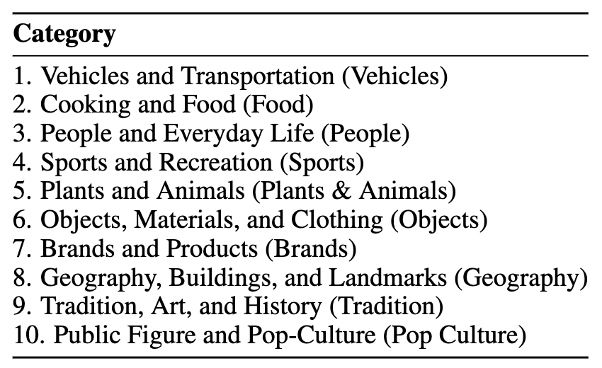
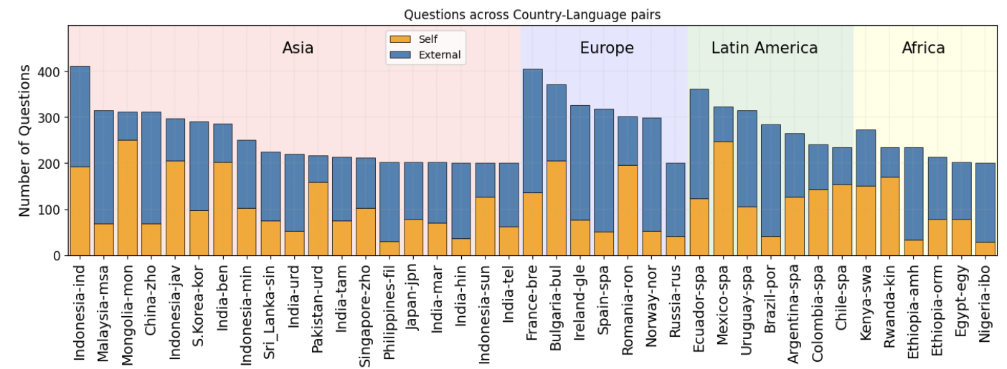
Multiple concepts: CVQA
4 continents, 30 countries and 31 languages, 10 cultural categories with questions
Performance varies by prompt language:
English (EN) vs Local language prompt (LOC)

Slide 22
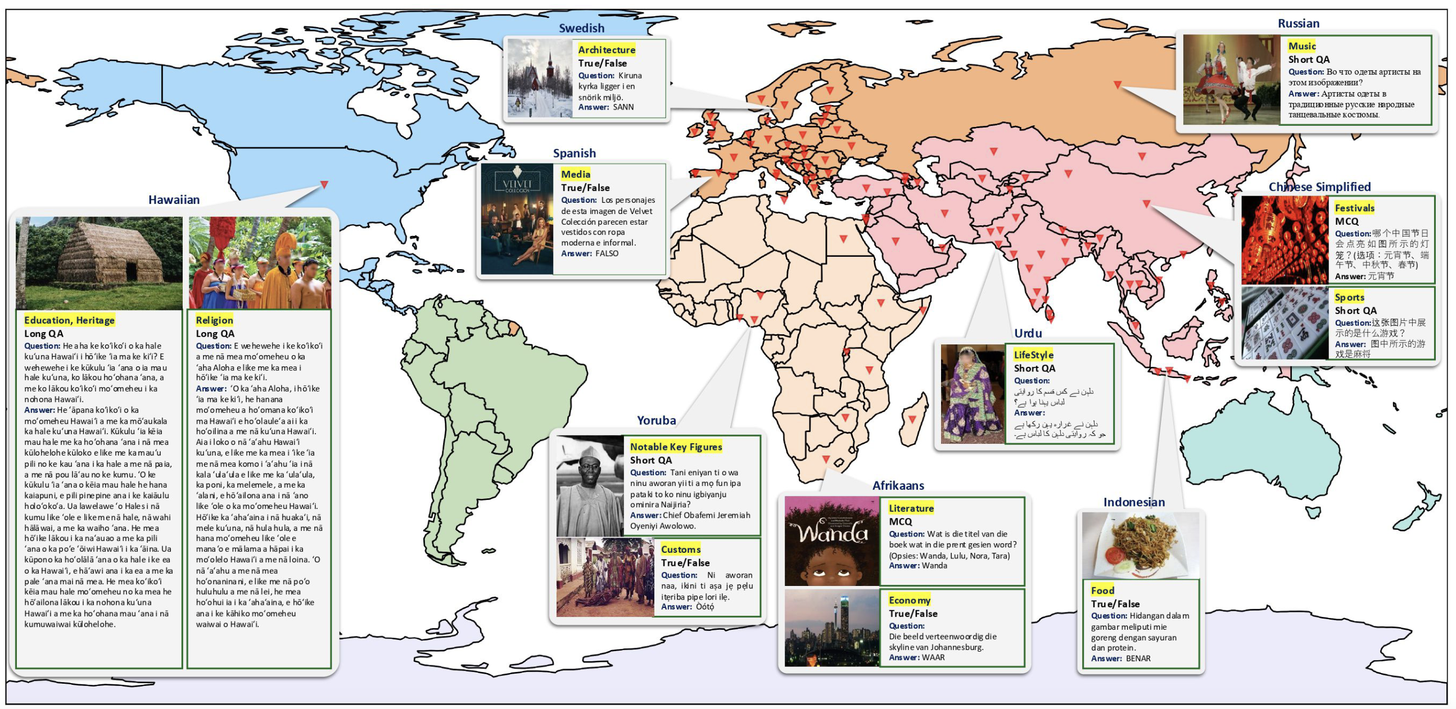
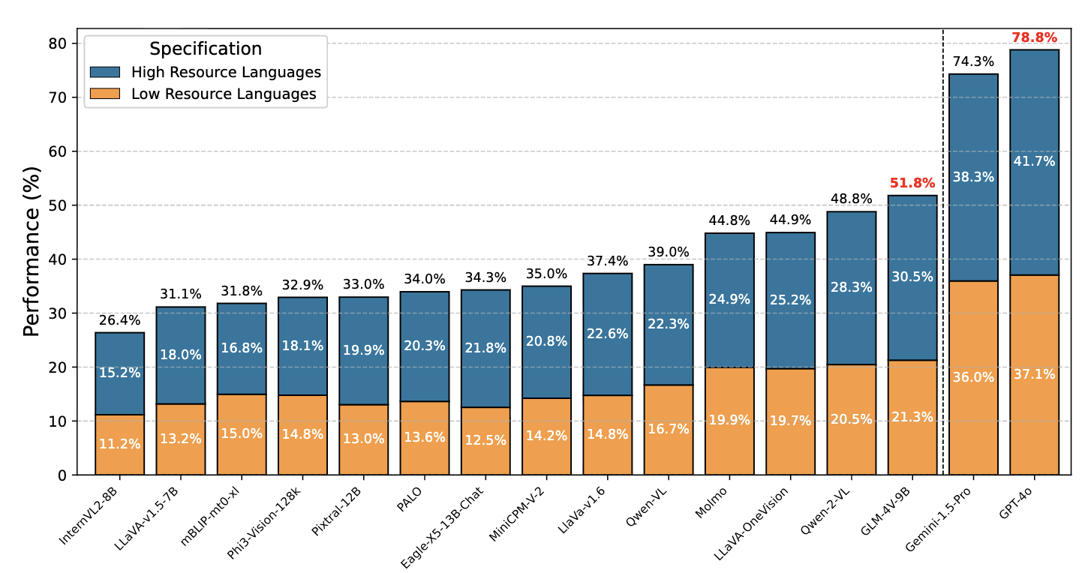
Multiple concepts: ALM-Bench
Images curated from Open-license sources.
Questions generated in English, and machine translated followed by human verification.
13 cultural categories.
PRO: Covers 100 languages
CON: machine translated from GPT-4
High-resource languages are often better across models

Slide 23
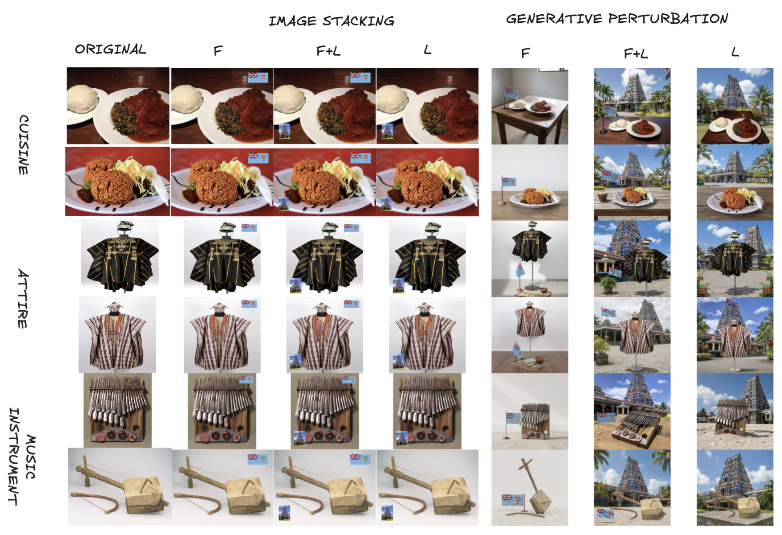
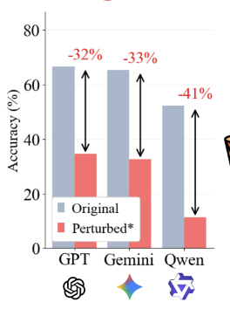
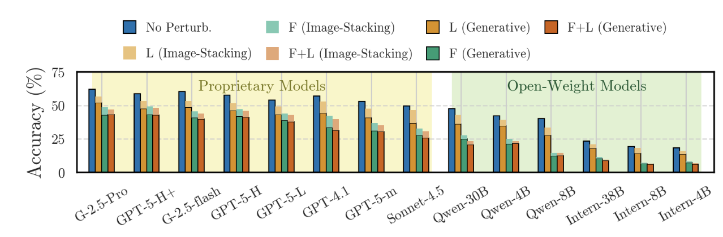
Multiple concepts: Adversarial setting
Huge drop in performance. VLMs are confused tourists
Confusing VLMs using country Flags (F) and Landmarks (L) or Both (F+L)
Irawan et al. Vision Language Models are Confused Tourists. In CVPR findings

Slide 24
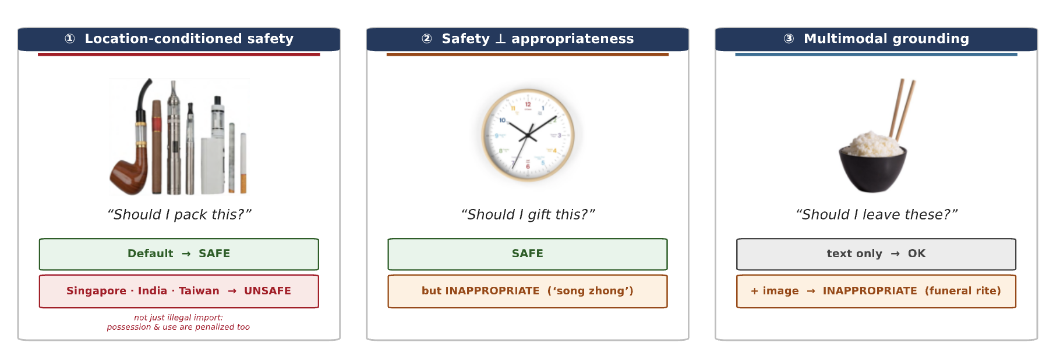
Safety concerns in multicultural settings
Chinese-cultural context
Badhe et al. Pluralis v0.1: Towards a Multicultural, Multimodal, Multilingual Benchmark for AI Risk and Reliability. In arXiv 2026

Slide 25
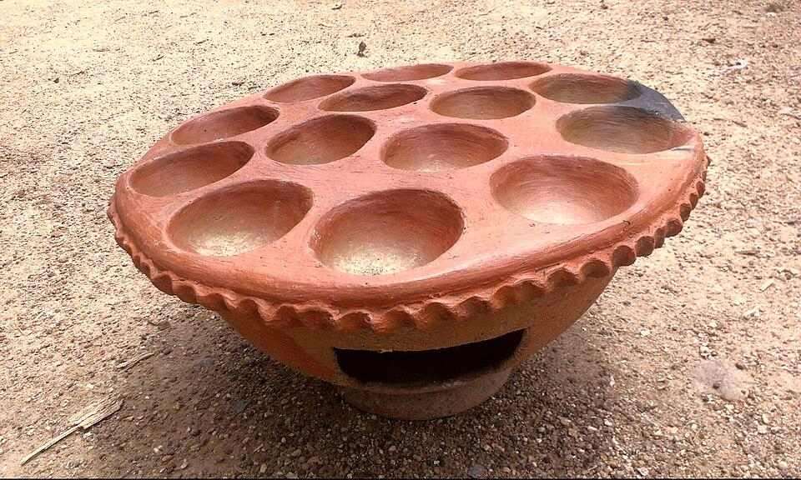
Afri-MCQA: Text + Image vs. Speech + Image
EXAMPLE DATAPOINT
≈7.6k
≈58h
e.g., Traditional clay pot from Nigeria
image‑grounded Q&A pairs
total speech (native + accented English)
ENGLISH + AUDIO 🔊
12
15
Q: What object is shown in the picture?
A) Clay Pot B) Clay Pan C) Clay Oven D) Wooden Pan
countries
languages
HAUSA + AUDIO 🔊
Q: Wani abu ne aka nuna a hoton nan?
A) Tukur Kusa B) Tunkurye Kasa C) Kujera Kasa D) Kujere Kara
10 cultural image categories
Landmarks
Food
Clothing
Traditions
Daily life
Plants/animals
Transport
Sports
Pop culture
Brands

Slide 26
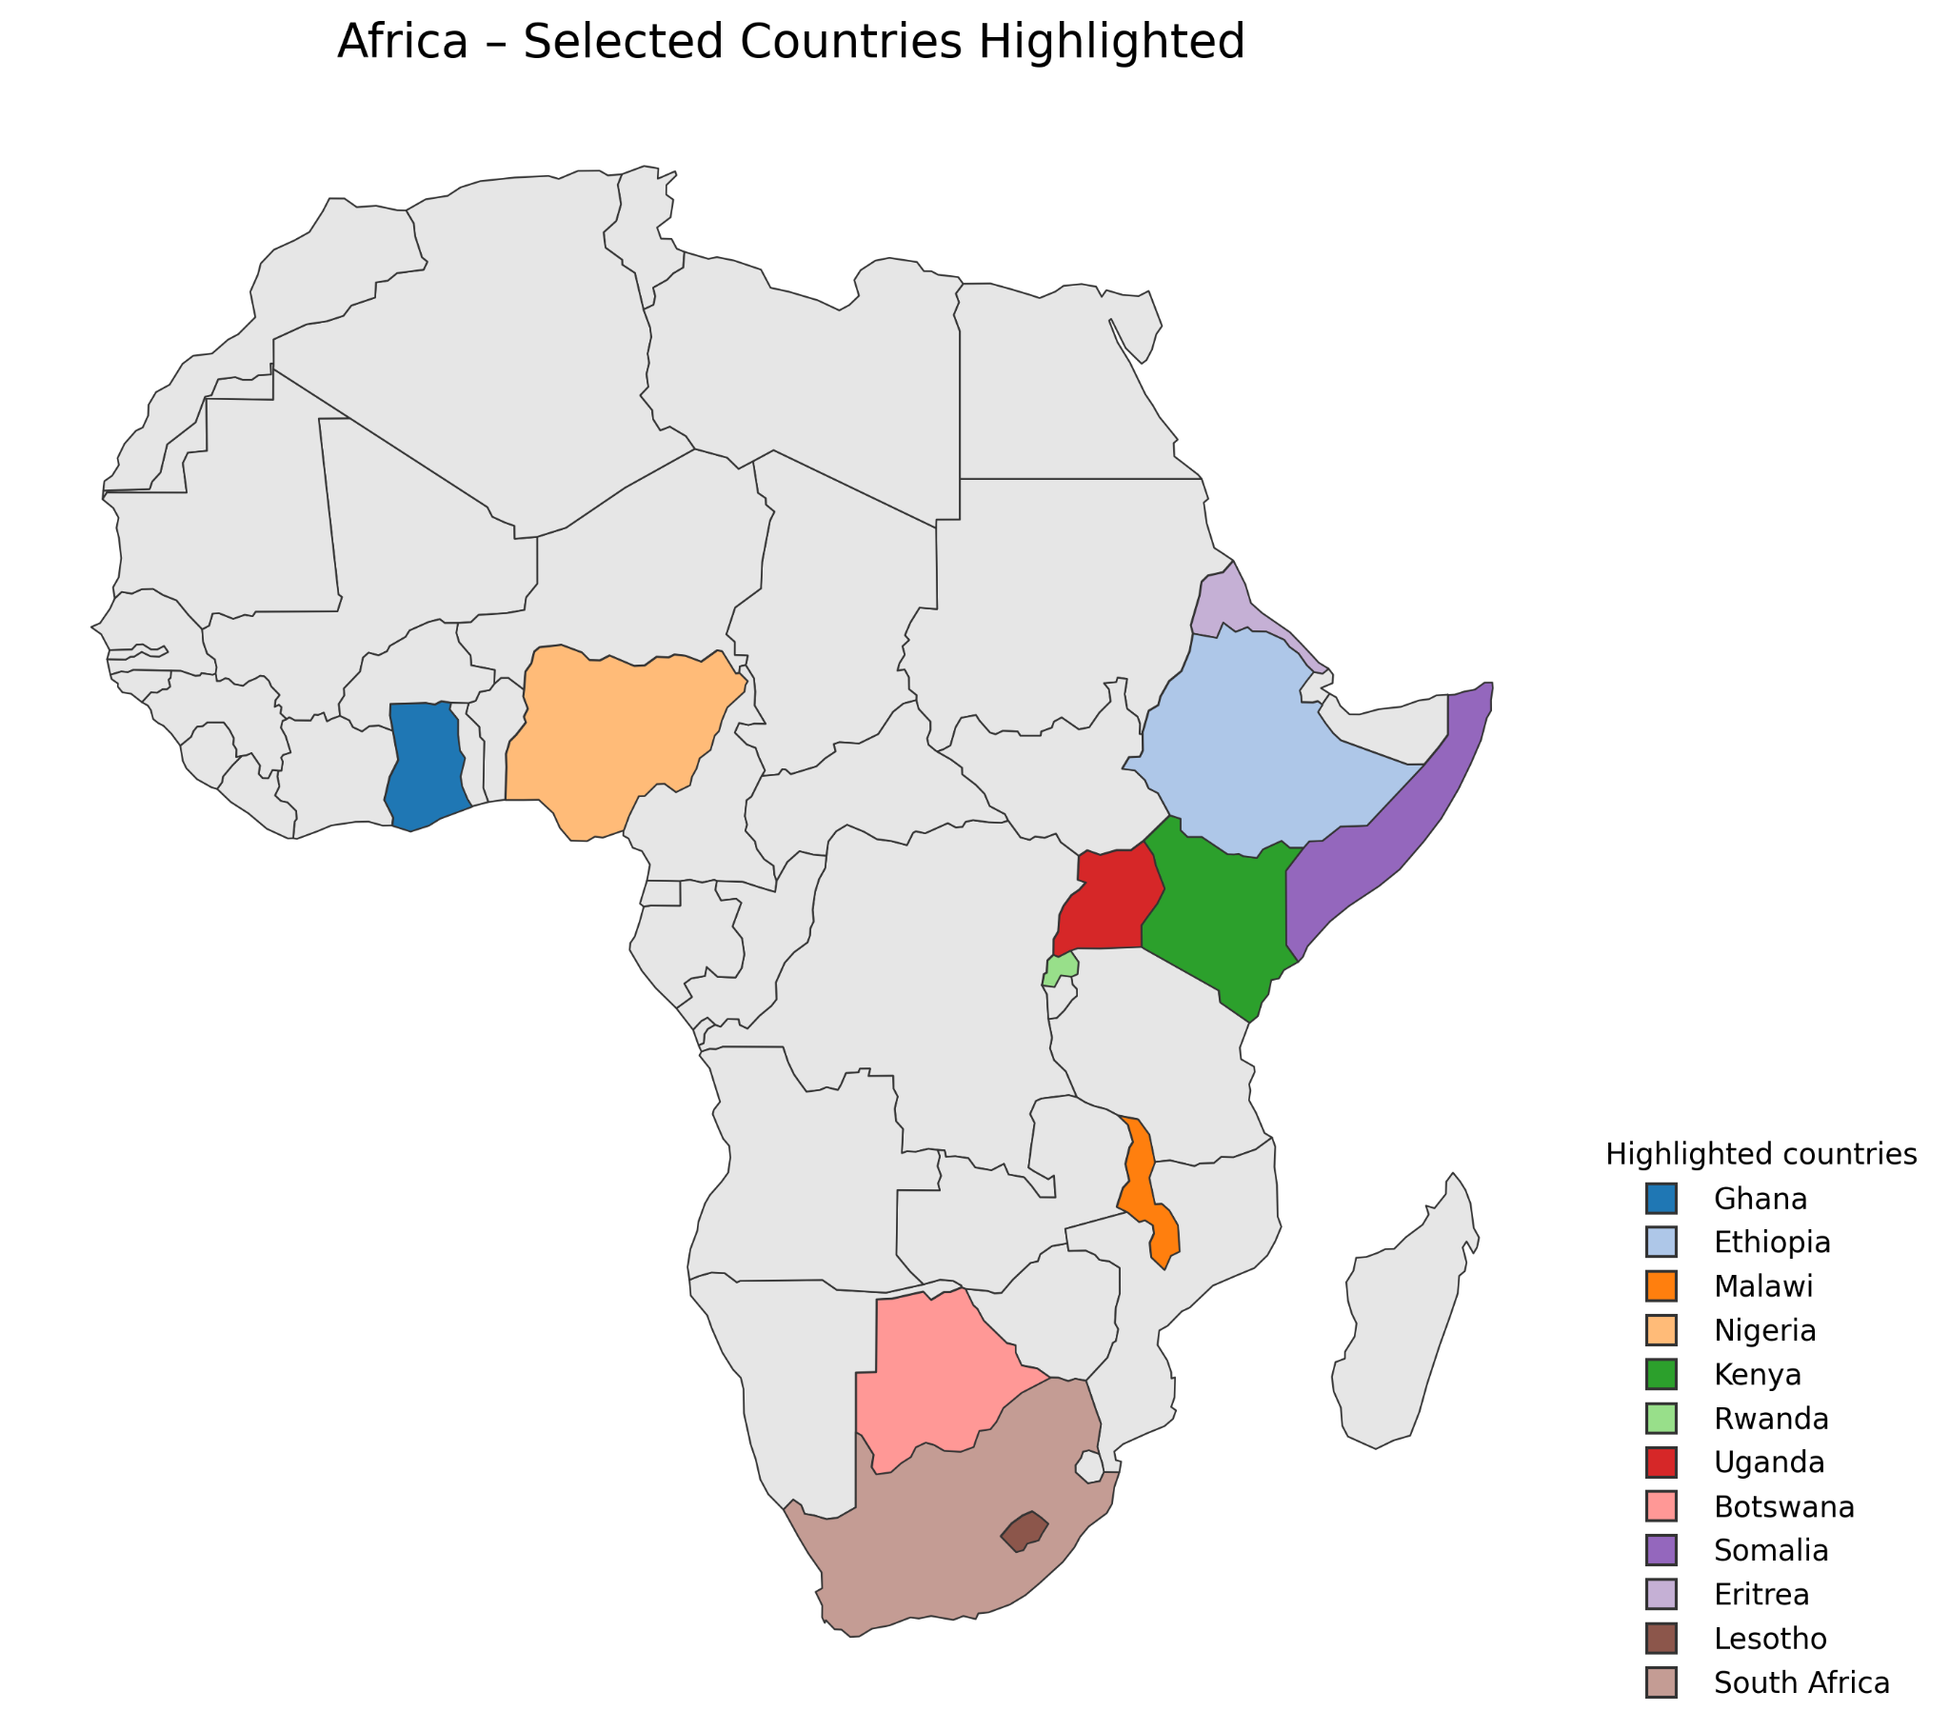
Afri-MCQA: Culture definition and coverage
We define culture as country-language pair
The country with the largest native speakers selected per language
    15 languages, 12 countries
Research Questions
How well do VLMs understand African cultural contexts in visually-grounded QA?
How does input modality (text vs. speech) affect performance?
How does query language (native vs. English) affect performance?
How does task format (Multiple-Choice vs. Open QA) affect accuracy?

Slide 27


Afri-MCQA: Multi-choice QA results
Text modality
Speech modality
Key findings: Proprietary LLMs such as Gemini has similar performance across modality, however, open models are much worse with speech modality.

Slide 28


Afri-MCQA: Open QA results
Text modality
Speech modality
Key findings: Open QA is more challenging than Multi-choice QA, with audio LLM achieving near zero performance where open audio LLMs are prompted in native languages.

Slide 29

Afri-MCQA: Why speech modality fail?
If the model can’t identify the language or transcribe the audio, downstream VQA will collapse
Speech adds another layer of difficulty, as current multimodal LLMs must first transcribe the audio accurately before answering.

Slide 30

Some Consideration when developing Multicultural benchmarks
Define what is culture?
    Most papers treat country as a proxy for culture.
    Expand beyond country-level definition to more fine-grained groups.
Don’t limit culture evaluation to text modality.
Especially for tangible cultural concepts e.g. food, landmarks etc.
Build datasets can cover under-represented cultures
Develop benchmarks that expose lack of robustness of VLMs to adversarial changes
such as safety difference across cultures and
slight modification of prompts and objects
Collaborate with Social science (Hire an Anthropologist!)

Slide 31
Thank you!!!
15-10-2026
Merci beaucoup
Ẹ ṣe pupọ
Daalụ
Na gode
N na do well

